Slide 1





Unlocking Revenue Potential in the Airbnb Marketplace
Airbnb Revenue Optimization & Performance Analytics
Sector: Short-Term Rental Marketplace
Team Members:Vaibhav Singh, Avneet Singh,
Alisha Gupta, Soumya Tiwari, Dhruv Kumar, Kushagra Bharadwaj.
Faculty Name: Ayushi Vashishth

Slide 2


Not all listings perform equally — why?
  Competitive short-term rental market
  Revenue varies by location & pricing
  Hosts face occupancy inefficiencies
Problem Statement:
Which neighbourhoods, room types, and pricing strategies maximize revenue and occupancy while maintaining ratings?
Objective: Enable data-driven hosting decisions.
Primary decision-makers: Airbnb hosts and property investors.

Slide 3


From Raw Listings to Business Intelligence
Content:
Source: NYC Airbnb Dataset
9,999 Listings | 25 Columns
Key Variables:
Price
Availability (365)
Room Type
Neighbourhood
Ratings
Derived Metrics:
Occupancy Rate
Estimated Annual Revenue

Slide 4
From Raw Data to Actionable Metrics
Cleaning:
Removed duplicates
Standardized pricing format
Handled missing ratings
Corrected inconsistencies
Engineered Metrics:
Occupancy Rate = (365 – Availability) / 365
Estimated Revenue = Price × Occupied Days

Slide 5
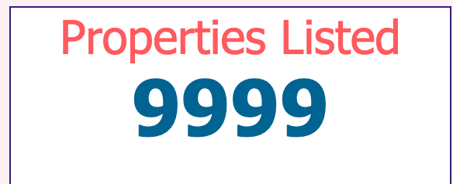
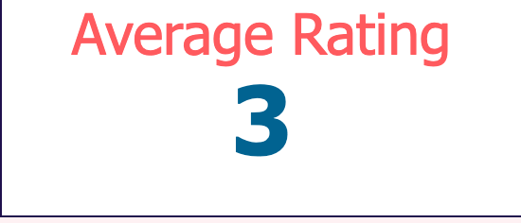
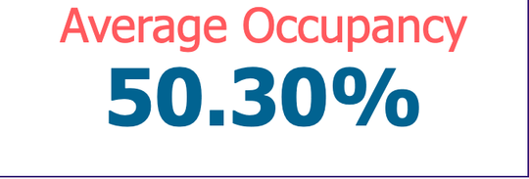

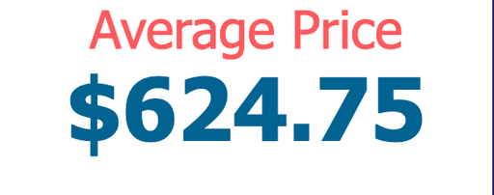
What Defines Listing Performance?
Total Listings
supply concentration
Average Rating
customer satisfaction
Occupancy Rate
to measure demand utilization
These KPIs directly evaluate revenue strength, demand efficiency, and market positioning.
Estimated Annual Revenue
to measure earning strength
Average Price
pricing benchmark

Slide 6

Revenue Is Highly Concentrated
Revenue clusters in Brooklyn neighbourhoods.
Entire homes generate premium revenue.
Occupancy averages ~45–50%.
Moderate pricing outperforms extremes.
Ratings remain consistent across categories.
Pricing impacts revenue more than occupancy alone.

Slide 7
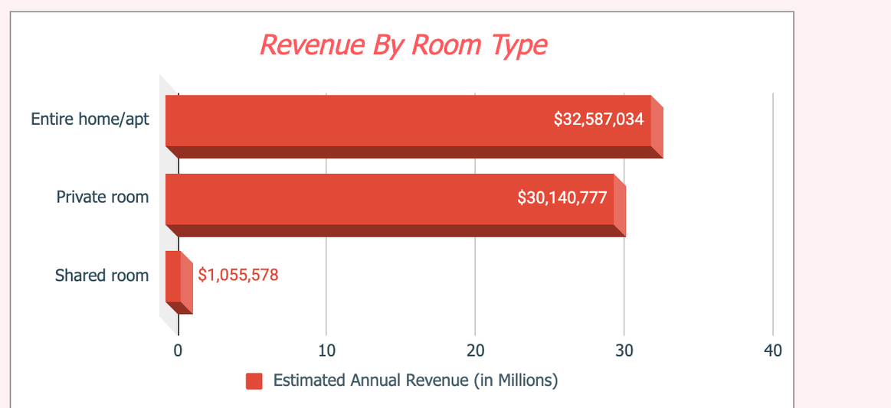
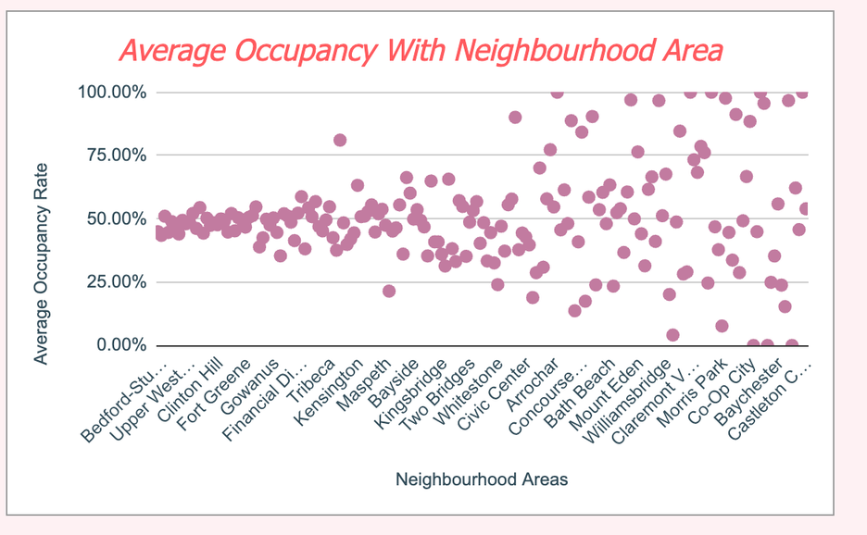
Pricing Drives Revenue More Than Occupancy Alone
Entire homes generate significantly higher revenue due to stronger pricing power.
Higher occupancy does not necessarily translate into higher revenue performance.

Slide 8

From Static Data to Dynamic Decisions
Data → Insights → Strategy → Revenue
Identify high-performing neighbourhoods.
Adjust pricing dynamically.
Monitor occupancy trends.
Act using real-time dashboard analytics.

Slide 9

Act on Data, Maximize Returns
Expand in top revenue neighbourhoods
Implement dynamic pricing strategies
Improve occupancy in mid-tier areas
Promote entire home premium positioning
Enhance listing quality

Slide 10

Small Optimization, Large Revenue Impact
5% occupancy increase → 5% revenue uplift.
8–10% pricing optimization → significant growth.
Reduced idle inventory.
Stronger investment decisions.

Slide 11

What We Know — And What We Can Improve
Limitations:
Estimated revenue
No seasonal data
Static dataset
The better you know your customer, the better you can help.
Next Steps:
Predictive pricing model
Seasonal forecasting
ML revenue modeling
Review sentiment analysis

Slide 12

Data-Driven Hosting Is the Future
The better you know your customer, the better you can help.
Location strategy and pricing optimization are the primary drivers of Airbnb performance.
Interactive dashboards enable smarter hosting decisions.

